Slide 1

Restaurant analysis
Jaya Krishna G
March 13th 2024

Slide 2
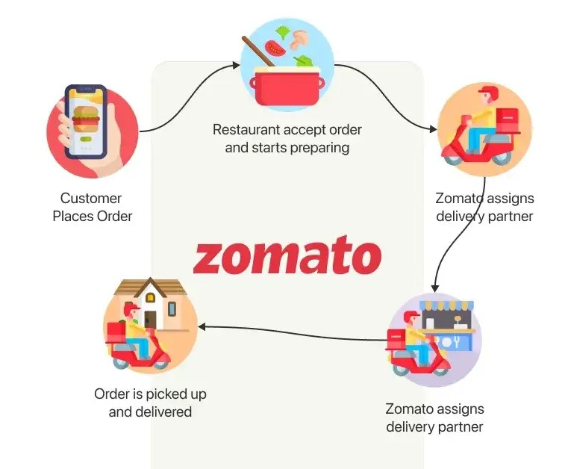
About Zomato
Zomato is an Indian food aggregator that connects customers with restaurants and delivery providers. Zomato provides information about restaurants, including menus, reviews, and ratings, and allows users to search for nearby restaurants, order food, and get it delivered to their doorstep.
Project involves analyzing data and market trends to identify potential locations, target demographics, and optimal restaurant concepts to maximize the success of the expansion efforts.

Slide 3

Data over view
Total number of restaurants:9551 are their across 15 different countries and 141 cities.
Most of the restaurants are present in India only nearly 8652, major cities are New Delhi, Gurgaon and Noida.
Data cleaning and preprocessing:
Seen for the duplicates to make sure the data is not repetitive .
Addressed missing values and blank values in the data to go for complete analysis.
This dataset provides comprehensive insights into restaurant performance and customer behavior across various countries.

Slide 4

Analytical approach and tools
Data cleaning: First seen for duplicates to ensure the data accuracy.
Data Enrichment: Used the string functions, text to column function and VLOOKUP function to enhance the data set with additional variables.
Descriptive analysis: Employed pivot tables for summarising the data and identifying restaurants performance across different countries.
Visualisation: Created dynamic charts and dashboards for data representation ,enabling interactive data exploration.

Slide 5
Major findings
Country | No of restaurants
India | 8652
United States of America | 434
United Kingdom | 80
Brazil | 60
South Africa | 60
United Arab Emirates | 60
New Zealand | 40
Turkey | 34
Australia | 24
Philippines | 22
Indonesia | 21
Sri Lanka | 20
Singapore | 20
Qatar | 20
Canada | 4
The dataset reveals that India has the largest number of restaurants, with a total of 8652 establishments, surpassing the count in any other country by a considerable margin."Following India, United states of America has 434 of restaurants.
Least we have details about only 4 restaurants in Canada.

Slide 6
Year | Restaurants opened
2010 | 1080
2011 | 1098
2012 | 1022
2013 | 1061
2014 | 1051
2015 | 1024
2016 | 1027
2017 | 1086
2018 | 1102
Indonesia has highest average votes for restaurants, from which we can conclude that more customers are visiting the restaurants compared to remaining countries and there is a high potential for opening newer restaurants there.
Above is a table illustrating the annual count of restaurant openings over several years.

Slide 7

Countries with high market potential to open new restaurants
Country
Australia
Canada
Sri Lanka
Qatar
United Kingdom
The following countries exhibit promising market potential for opening new restaurants. These countries have restaurants having less rating, high average cost for two people and sufficient average votes.

Slide 8
EXPENDITURE ON FOOD IN SELECTED COUNTRIES
Average votes for restaurants in different price range
Country | 1(Less) | 2(Medium) | 3(High) | 4(very high)
Australia | 80 | 87 | 225 | 16
Canada |  | 69 |  | 204
Qatar |  | 211 | 227 | 138
Sri Lanka |  | 139 | 139 | 188
United Kingdom | 19 | 181 | 197 | 311
Average votes for restaurants in different average cost range in rupee
Country | 0-500 | 500-1500 | 1500-3000 | 3000-5000 | >5000
Australia |  | 80 | 123 |  | 16
Canada |  |  | 69 |  | 204
Qatar |  | 267 | 203 | 150 | 131
Sri Lanka | 139 | 150
United Kingdom |  | 26 | 107 | 193 | 287
Based on the insights from the above analysis we can conclude that newer restaurants should have average cost for two people and price range as shown below to keep expenditures in control.
Country | Price range | Cost range for two people
Australia | 3 | 1500-3000
Canada | 4 | >5000
Qatar | 3 | 500-1500
Sri Lanka | 4 | 500-1500
United Kingdom | 4 | >5000

Slide 9

Attributes affect on enhancing rating
When considering online delivery and table booking options, restaurants offering these services tend to receive higher average ratings compared to those that do not provide such amenities.
Opening restaurants with this facilities will enhance rating and gives positive feedback from customers.

Slide 10
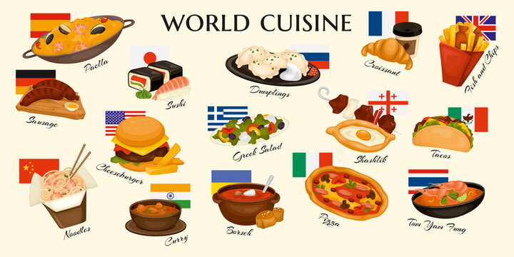
Cuisine selection
Customers' preferences for cuisines vary across different localities. By considering the specific cuisine preferences of customers in each locality, we can tailor the menu selection for newly opened restaurants accordingly.

Slide 11
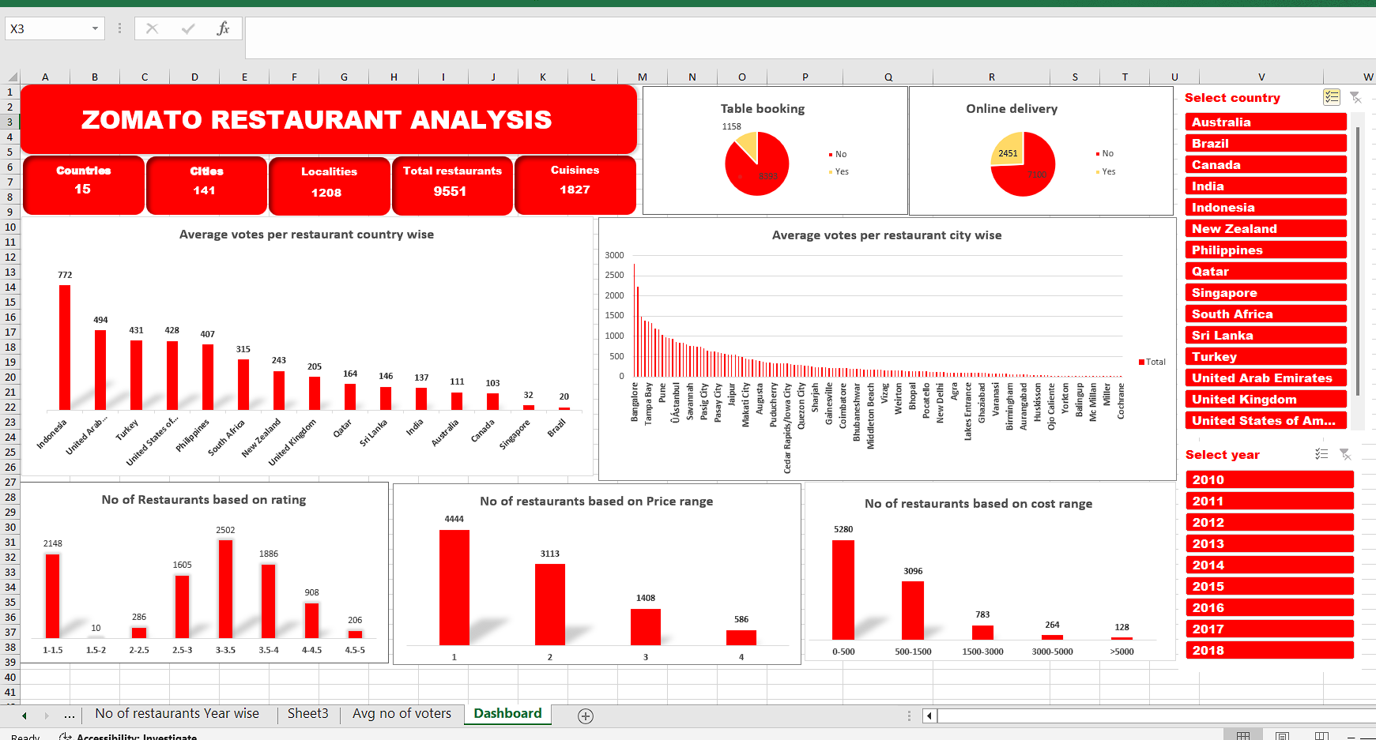
Dashboard to get overview on data

Slide 12

Potential zones: We have identified high-performing restaurant areas where opening new establishments would be advantageous.
Incorporating features such as online delivery and table booking can elevate restaurant ratings and draw in a larger customer base.
We will set the prices of our restaurants based on the price range in that specific area, ensuring affordability for customers while also competing with existing restaurants in the region.

Slide 13

References
Data: Zomato restaurants data set
Tools used: MS Excel 2016

